Slide 1
Lecture 7 - Segmentation based on K-means clustering
Yanwen Wang
Sauder School of Business
University of British Columbia
March 2018

Slide 2
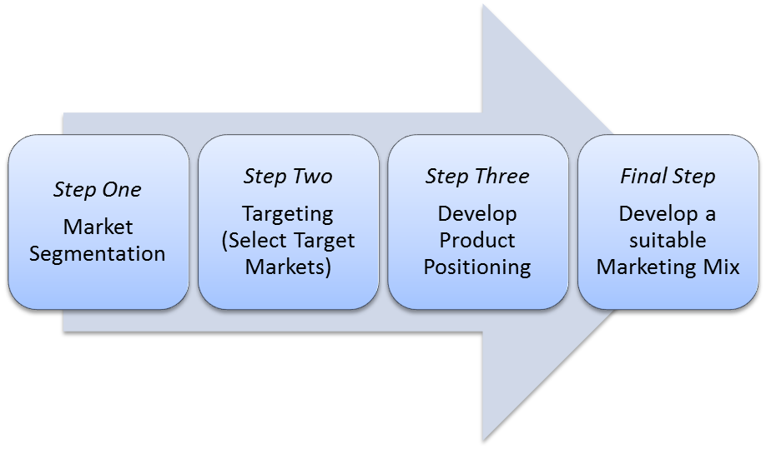

Slide 3
The dilemma
Market aggregation
(Homogenous market)
Market segmentation
(Heterogeneous market)
Lower costs
Higher revenue

Slide 4
Segmentation assumptions
It is possible to identify and isolate groups of individuals (segments) within the total market who demand different kinds of product characteristics and/or react differently to the marketing mix (product, price, place, promotion).
The marketer is willing to select “target segments” whose needs s/he can best fulfill, and concentrate efforts on reaching and persuading primarily this portion of the total market.
If more than one target segment is desirable, the marketer is willing to design different marketing strategies and tactics for each segment

Slide 5
Segmentation criteria
Segments should:
be internally homogenous and distinctive in a strategically meaningful way
be operational: measurable and accessible
have effective demand

Slide 6
The clustering process
Select variables on which to cluster
Select a clustering method
Determine the number of clusters
Conduct the cluster analysis and interpret the results

Slide 7
Selecting variables on which to cluster
Benefits sought
Psychographics
Demographics
Geo-demographics
Behavior (e.g., RFM)
Competitive measures (e.g., share of wallet)
Customer value (e.g., CLV)

Slide 8
Select a clustering method
Agglomerative method
Hierarchical clustering
Divisive method
K-means clustering
Nonhierarchical clustering
Probabilistic clustering
Self-organizing map
Notes:
p 408

Slide 9
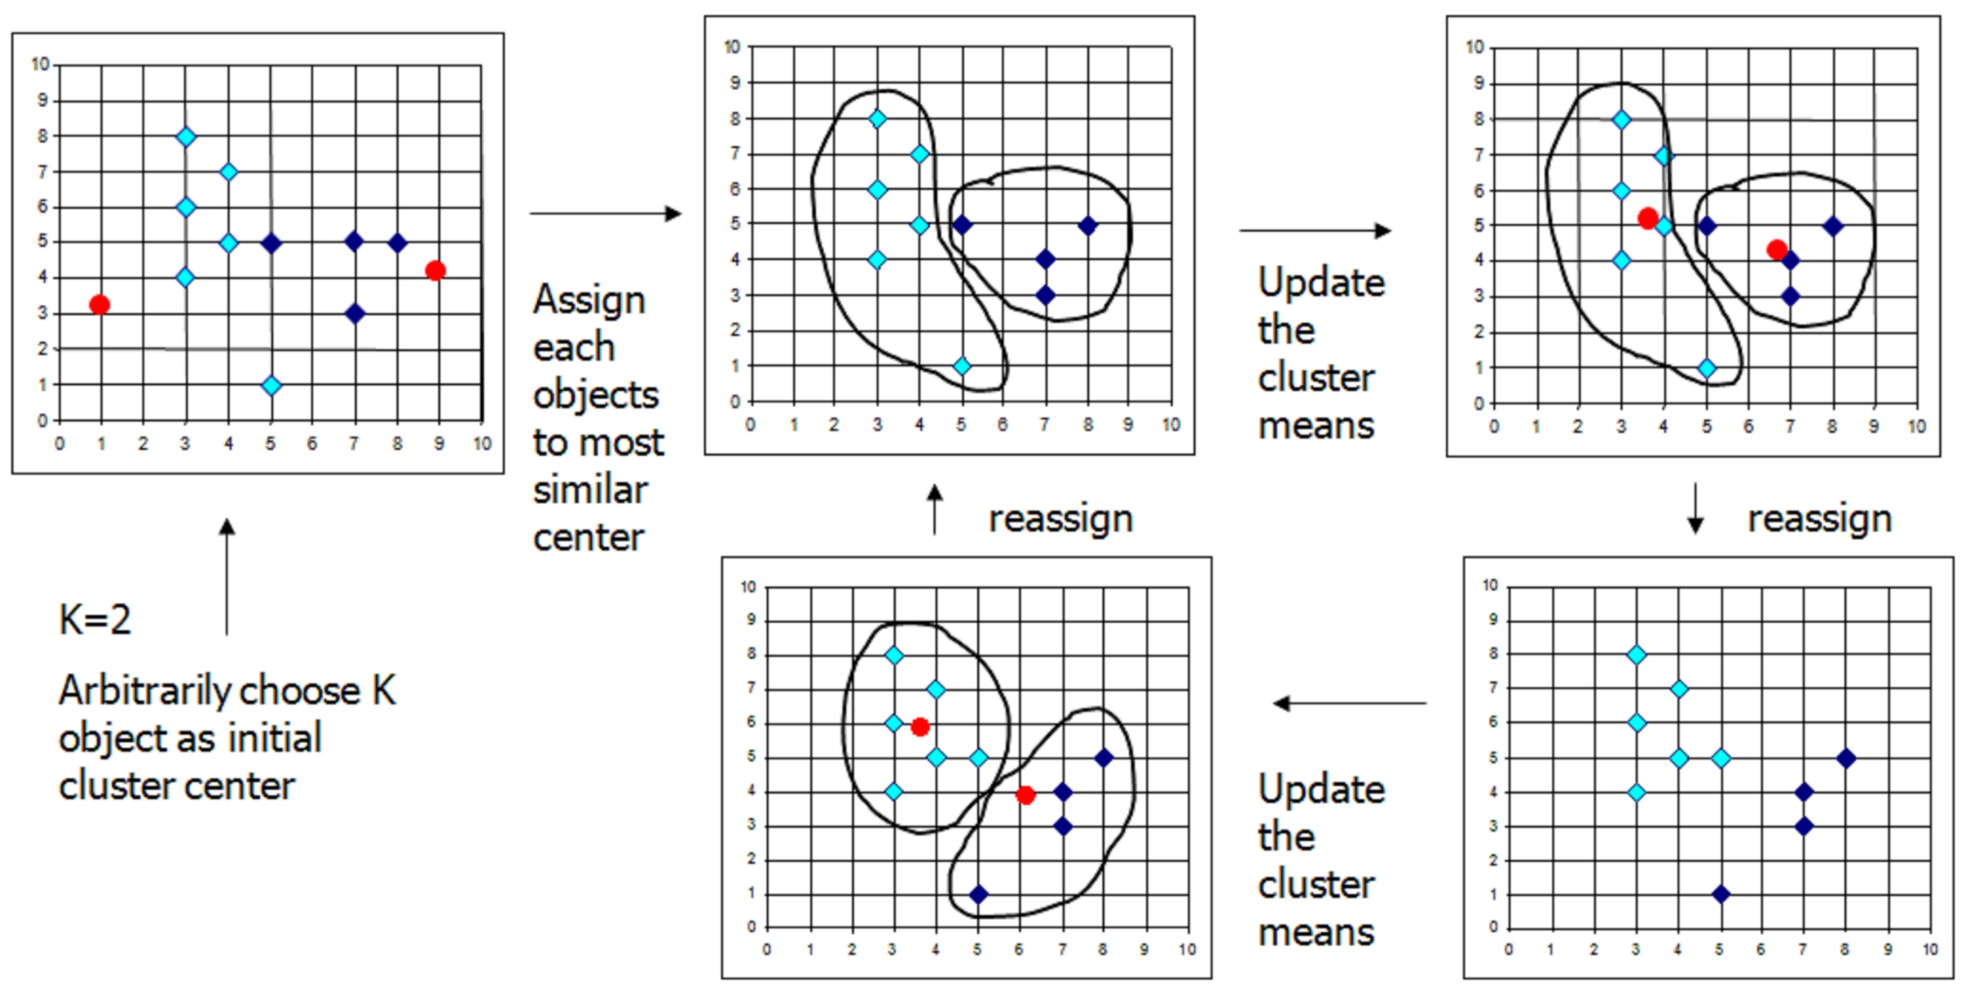
The k-means algorithm: to minimize the within-cluster sum of distance of each point in the cluster to the K center

Slide 10
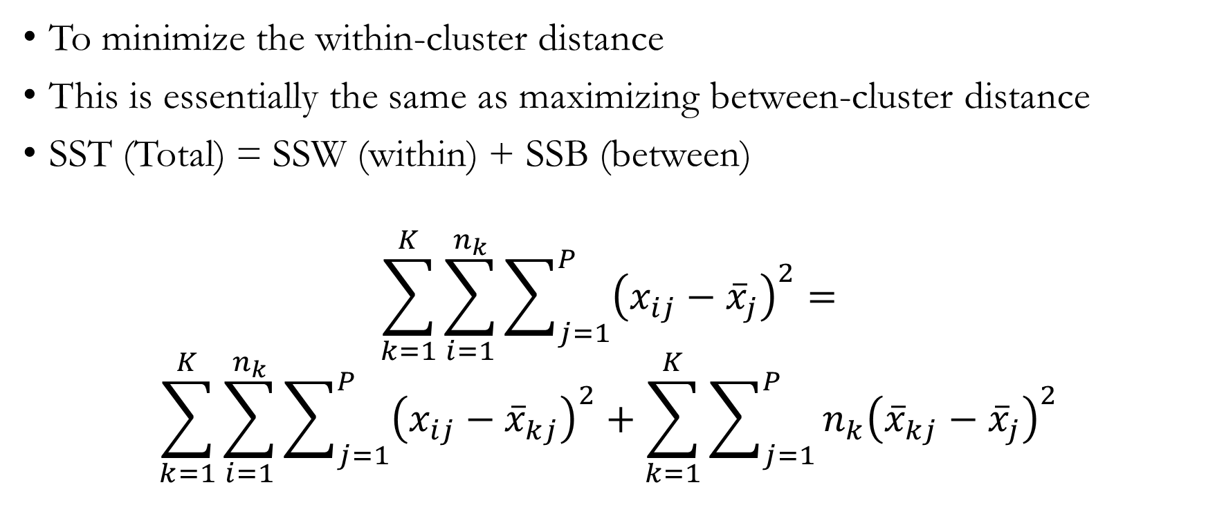
K-means (Expectation Maximization Method)
To minimize the within-cluster distance
This is essentially the same as maximizing between-cluster distance
SST (Total) = SSW (within) + SSB (between)
$$\sum_{k=1}^{K}{\sum_{i=1}^{n_{k}}{\sum_{j=1}^{P}{{\left(x_{ij}−{\overline{x}}_{j}\right)}^{2}}}}=$$
$$\sum_{k=1}^{K}{\sum_{i=1}^{n_{k}}{\sum_{j=1}^{P}{{\left(x_{ij}−{\overline{x}}_{kj}\right)}^{2}}}}+\sum_{k=1}^{K}{\sum_{j=1}^{P}{{n_{k}\left({\overline{x}}_{kj}−{\overline{x}}_{j}\right)}^{2}}}$$
Notes:
Each centroid defines one of the clusters. In this step, each data point is assigned to its nearest centroid, based on the squared Euclidean distance. Next, the centroids are recomputed.

Slide 11

Manhattan distance (city block)
Distance between a customer and a cluster center is calculated by summing the difference between the two points for each dimension
$$1+2=3$$
3
2
1
1
2
3
Notes:
The Manhattan distance function computes the distance that would be traveled to get from one data point to the other if a grid-like path is followed. The Manhattan distance between two items is the sum of the differences of their corresponding components.

Slide 12

(Squared) Euclidean distance (as-the-crow-flies)
Distance between a customer and a cluster center is calculated by taking the difference between the two points for each dimension, squaring the differences, and summing them up.
$$12+22=5$$
3
2
1
1
2
3

Slide 13
K-Means Clustering Chicago Theater Data

Slide 14
Segmentation analysis for Chicago theaters
Five theaters that stage non-musical plays in Chicago joined forces to develop a marketing plan. The group of theaters is called North Shore Live. In addition to the segment of current theater attendees, the group wants to attract people who do not currently attend theater productions. In developing a marketing plan, the group conducted a marketing research study in which they recruited a random sample of approximately 3,000 adults living in the Chicago area to complete a survey. Data for this sample are in “theater.csv”. The survey data comprises 5 variables:
attitude: 1 = “dislike”; 7 = “like”
planning: 1 = “spur of the moment”; 7 = “requires planning”
parents: 1 = “my parents disliked plays”; 7 = “my parents liked plays”
goodval: 1 = “too expensive”; 7 = “good value for the money”
getto: 1 = “hard to get to”; 7 = “easy to get to”

Slide 15
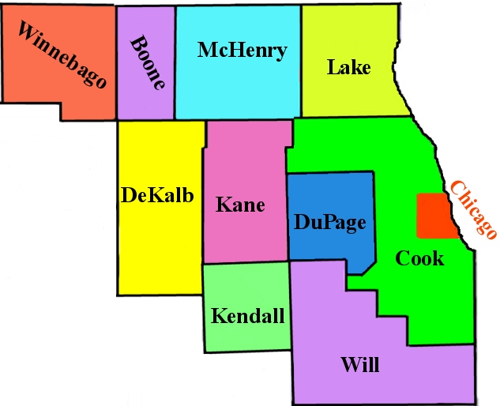
Segmentation analysis for Chicago theaters

Slide 16
Determining the number of clusters
One of the most difficult problems in clustering. Can be based on:
Managerial judgment:
Are the clusters large enough to be managerially meaningful?
Are the clusters actionable? Is it feasible to target specific segments and develop a cost-effective marketing mix?
Statistics
Within-group sum of squares
Within-group divided by between-group sum of squares
Pseudo F

Slide 17
Interpreting the results
Cluster 2 is above average on all dimensions. Members of this cluster have the most positive attitude toward theater, rate it highest on its value for money, and find it easy to get to. Their parents attended plays more than average, and they are about average on the perceived amount of planning.
Cluster 3 is below average on all dimensions. Members of this cluster find it somewhat difficult to get to a play, rate the value for the money below average; and have the most negative overall attitude of the three clusters. Their parents were substantially less likely to attend plays. They rate the amount of planning as quite low (which is not a bad thing).
Cluster 1 is more mixed. They have a good attitude toward theater and their parents attended more than average, but they believe it requires a lot of planning, is difficult to get to and is not a good value for money.

Slide 18
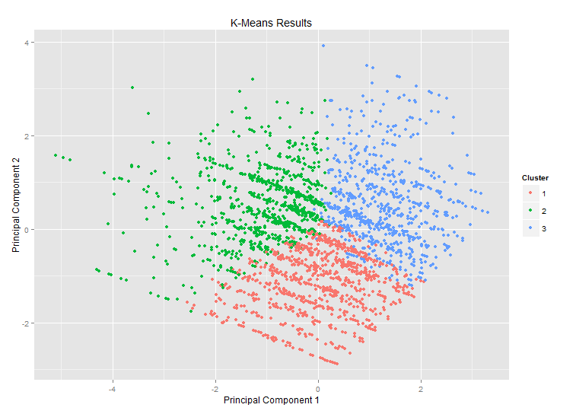
LOW SACRIFICE
HIGH SACRIFICE
LOW BENEFIT
HIGH BENEFIT

Slide 19
Profiling clusters
Cluster 1 tends to be younger, highly educated, and more likely to live in Lake County to the north of Chicago.
Cluster 3 tends to be less educated.
Cluster 2 tends to be highly educated and more likely to have a Chicago residence.

Slide 20
K-Means Clustering Wine Offers

Slide 21
Segmentation analysis for wine merchant
A wine merchant travels the globe finding incredible deals on large quantities of wine. The merchant ships the wines to the US and sells it to select wine and liquor stores across the country at a profit. The merchant reaches out to his customers once a month with an email newsletter. There are two to three deals in each email, perhaps one would be on Champagne, another one Malbec. In total, the merchant has offered 32 deals this year. The merchant wants to segment his list of customers based on interest with the aim of sending customized newsletters in the future. The merchant’s data is in “wine data.csv”. The offers differ in terms of varietal, minimum bottle quantity for purchase, discount off retail, whether the wine is past its peak, and country or state of origin.

Slide 22
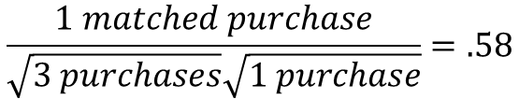
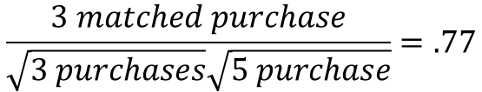
Customer | Item 1 | Item 2 | Item 3 | Item 4 | Item 5
1 | 1 | 1 | 0 | 0 | 1
2 | 0 | 0 | 0 | 0 | 1
3 | 1 | 1 | 1 | 1 | 1
Is customer 1 most similar to customer 2 or customer 3?
$$\frac{1 matched purchase}{\sqrt{3 purchases}\sqrt{1 purchase}}=.58$$
<
$$\frac{3 matched purchase}{\sqrt{3 purchases}\sqrt{5 purchase}}=.77$$
Notes:
Although number of matches is identical (3 for both customers 2 and 3), and thus Euclidean distance is the same

Slide 23
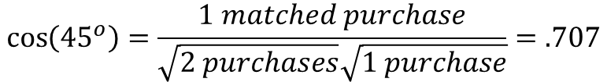
Cosine similarity – definition
Cosine similarity is equal to the count of matched purchases in the two vectors divided by the product of the square root of the number of purchases in the first vector times the square root of the number of purchases in the second vector.
(1,1)
45 degree angle
(1,0)
$$\cos\left({45}^{o}\right)=\frac{1 matched purchase}{\sqrt{2 purchases}\sqrt{1 purchase}}=.707$$

Slide 24
Cosine similarity – properties
The numerator counts the number of matched purchases only, so it is an asymmetric measure.
By dividing through by the square root of the number of purchases, you’re accounting for the fact that a vector where everything is purchased is farther away from another vector than one who matches on the same deals and has not taken as many other deals.
For binary data, this similarity value ranges between 0 and 1, where two vectors don’t get a 1 unless their purchases are identical. This means that 1 – cosine similarity can be used as a distance metric called cosine distance which also ranges between 0 and 1.
(1,1)
45 degree angle
(1,0)
$$\cos\left({45}^{o}\right)=\frac{1 matched purchase}{\sqrt{2 purchases}\sqrt{1 purchase}}=.707$$
Notes:
110 is more similar to 110 than to 111

Slide 25
K-means clustering with cosine distance
AKA Spherical k-means (R package: “skmeans”)
Advantages:
Works better with sparse data (i.e., datasets with relatively few purchases or 1s)
Recognizes that purchases are more informative than non-purchases. That is, if a customer matches another customer on three 1s, that’s more important than matching some other customer on three 0s.
Notes:
00010 and 00001 would have high Euclidean similarity but zero cosine similarity

Slide 26
Interpreting the 3-cluster solution
Cluster 1 is Champagne
Cluster 2 is Pinot Noir
Cluster 3 is Low volume

Slide 27
Hierarchical Clustering Wine Offers

Slide 28
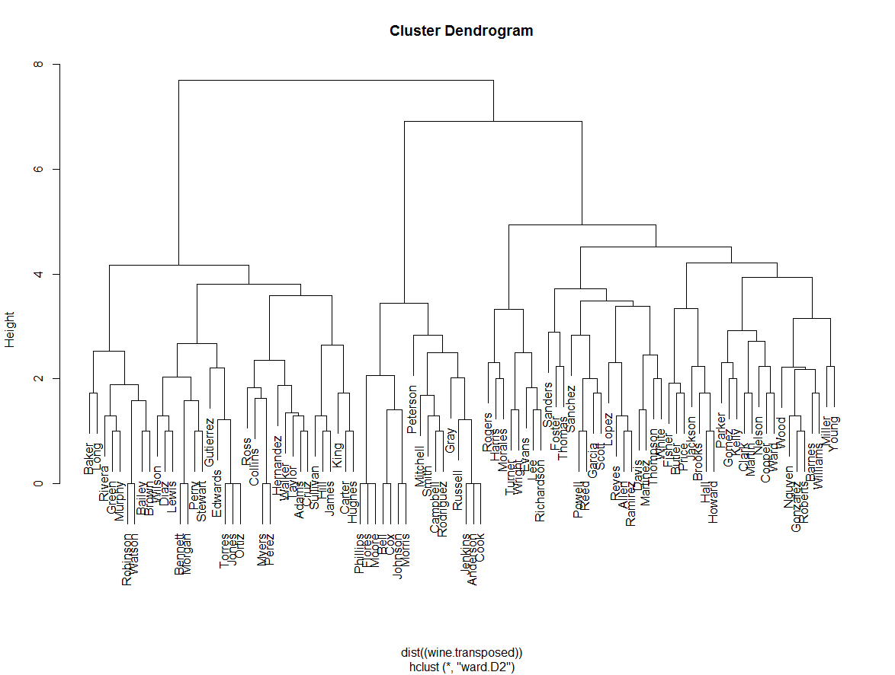

Slide 29
Clustering Analysis in Python

Slide 30
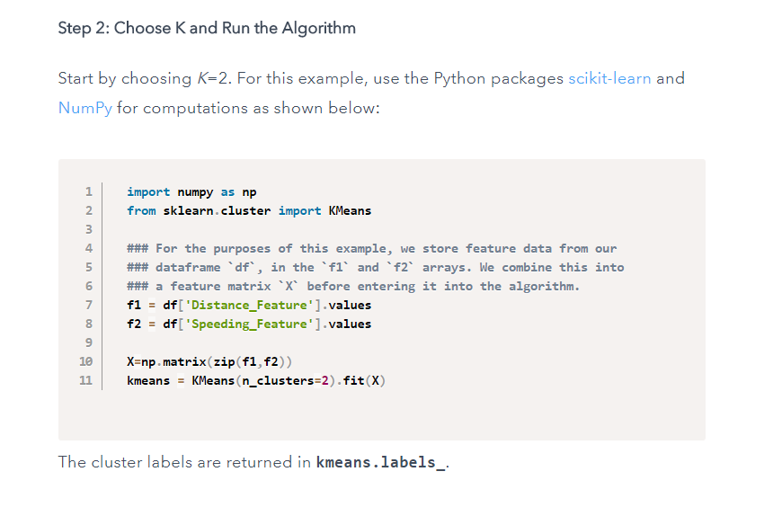

Slide 31
Applications of Clustering Analysis Surge Pricing (UBER)
Not required for exam or exercise

Slide 32
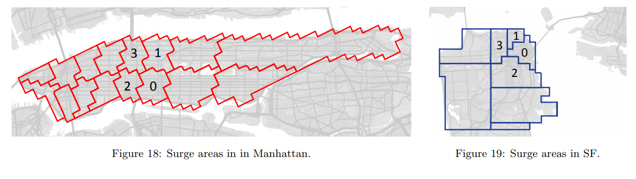
Surge Areas - How do surge prices vary by location?
Source: Chen, Mislove, and Wilson (2015)

Slide 33
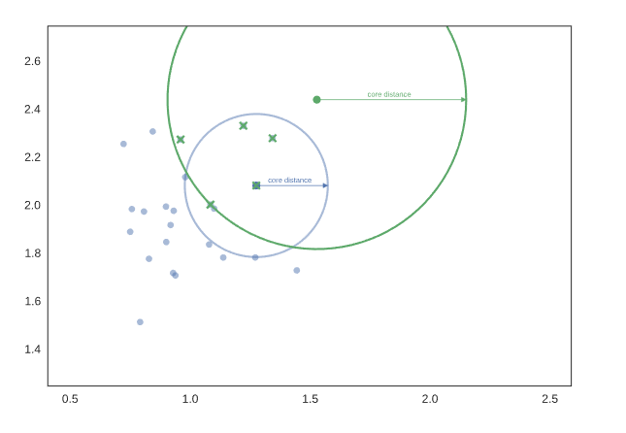
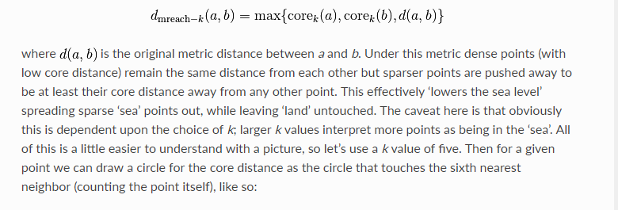
Hierarchical Density Based Spatial Clustering

Slide 34
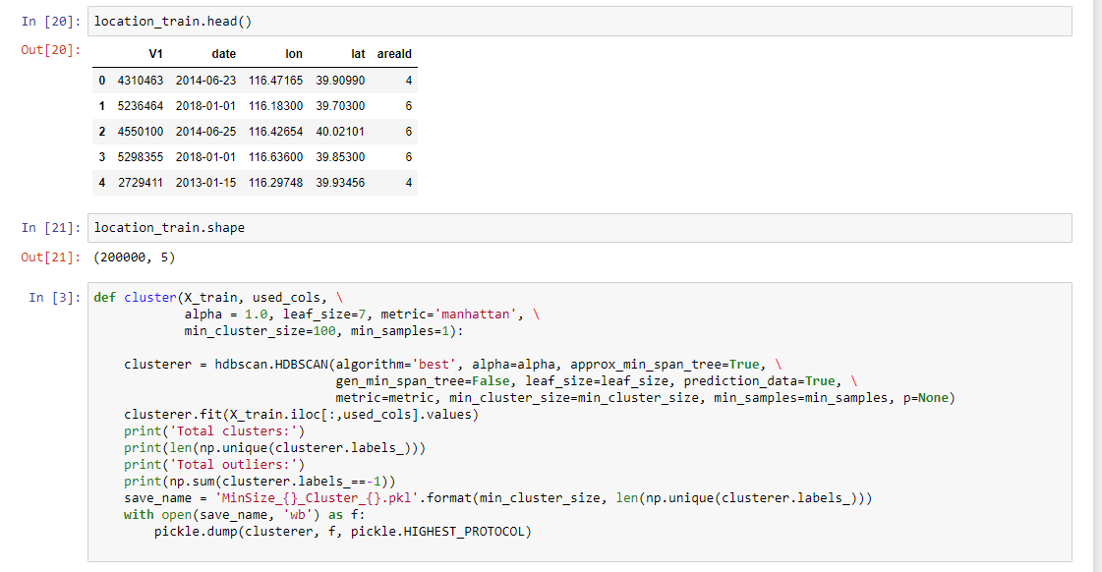
HDBSCAN in Python

Slide 35
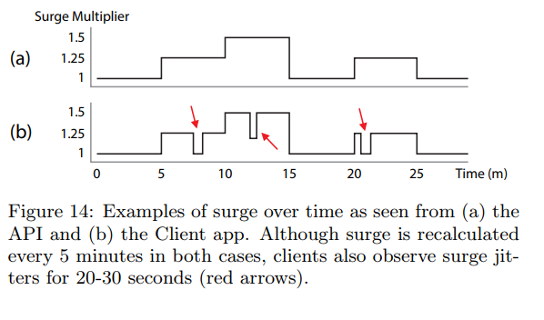
Surge Areas - How do surge prices vary by time?
Source: Chen, Mislove, and Wilson (2015)

